Slide 1
Box Model
Box Model Component | Box Sizing | Content Width and Height | Border Styles | Margin collapsing and horizontal centering |
Notes:
Welcome to out lecture on CSS box model. In this lecture we will go through box model components, box sizing, content width and height, border styles, and margin collapsing and horizontal centering. Let’s start our lecture.

Slide 2
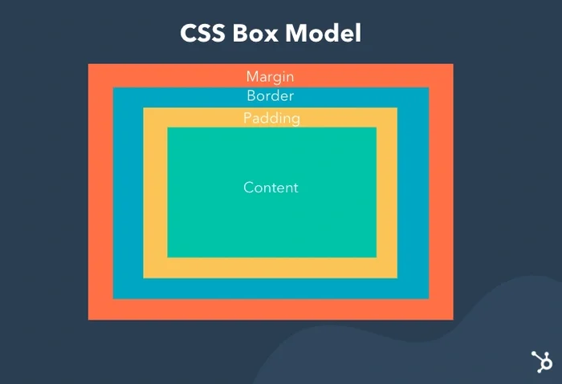
Box Model Components
The box model describes the size of each element as a series of nested boxes.
Content: Contains the element's core content (e.g., text, images).
Padding: Surrounds the content with transparent space.
Border: Encases padded content, optionally colored.
Margin: Adds transparent space around the border and all inner boxes.
Notes:
The box model defines the size of an element using nested boxes. The content box holds the core content like text or images. The padding box adds transparent space around the content. The border box surrounds the padding and can have color or style. The margin box creates transparent space around the border, separating the element from others. This model helps in precise layout design.

Slide 3
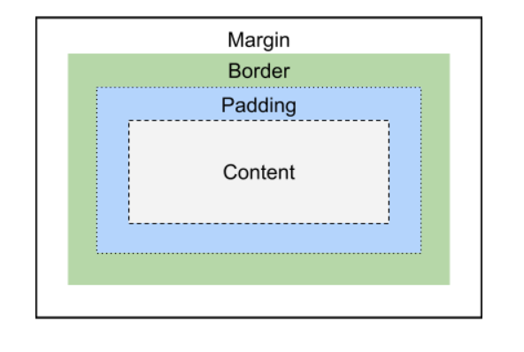
Box Model With Label Boxes
Notes:
The box model organizes an element into four areas. The content box holds the actual content like text or images. Surrounding it is the padding, which adds space between the content and the border. The border encloses the padding and can have custom styles. The margin is the outermost layer, adding space between the element and its surroundings. This model ensures structured and consistent layouts.

Slide 4
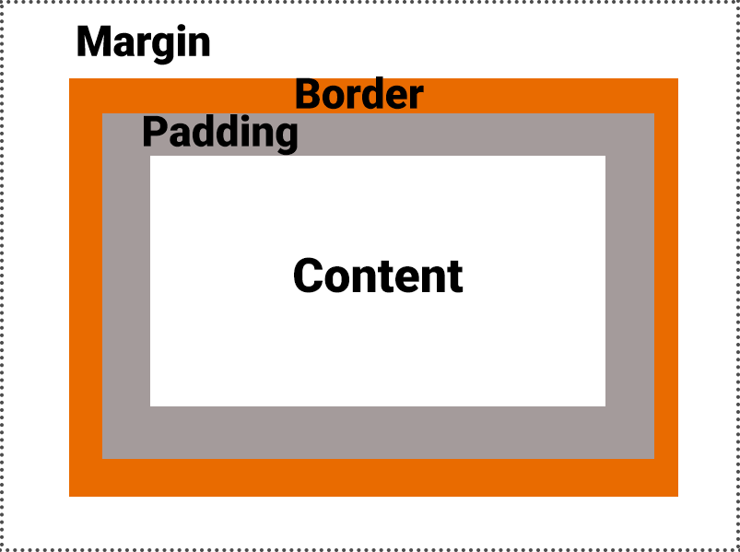
CSS Properties
CSS properties that controls padding, margins, and border are:
Padding: Defines padding thickness (e.g., padding: 5px;).
Border: Specifies thickness, style, and color (e.g., border: 2px solid blue;).
Margin: Sets margin thickness (e.g., margin: 10px;).
Notes:
These CSS properties define spacing and styling around elements. Padding adds space inside the element around the content, set using padding values like padding 5px. Borders surround the padding, defining thickness, style, and color, such as border 2px solid blue. Margins create space outside the border, separating elements, set using values like margin 10px. These properties structure and style layouts effectively.

Slide 5
CSS Rules for Margin, Padding, Border
Content: Displays with the element's background color.
Padding: Transparent, matches the element's background color.
Border: Can be colored or transparent, matching the padding if transparent.
Margin: Transparent, matches the parent element's background color.
Notes:
Next comes CSS rules that defines specific rules for content, padding, border, and margin. Content displays with the element's background color. Padding is transparent but matches the background color of the element. Borders can be colored or transparent, and if transparent, they match the padding. Margins are transparent and match the parent element's background color, creating spacing between elements.

Slide 6
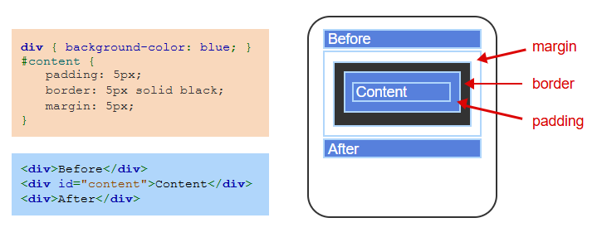
Example
Notes:
This example demonstrates the box model in CSS. The content div has 5px padding inside the border, creating space between the content and the border. The border is styled with a 5px solid black outline. Additionally, there is a 5px margin outside the border, creating spacing between the content and surrounding elements. The box model ensures proper spacing and layout structure for the element.

Slide 7
Box Sizing
The padding and margin properties may have from 1 to 4 values:
One value: Uniform thickness for all sides (e.g., margin: 20px;).
Two values: Top/bottom and right/left (e.g., margin: 10px 20px;).
Three values: Top, right/left, and bottom (e.g., margin: 10px 30px 20px;).
Four values: Top, right, bottom, and left (e.g., margin: 10px 30px 20px 40px;).
Notes:
Let’s discuss box sizing. CSS padding and margin properties accept 1 to 4 values to define spacing. One value applies uniform thickness to all sides, like margin 20px. Two values set top and bottom, and right and left, like margin 10px 20px. Three values define top, right/left, and bottom, like margin 10px 30px 20px. Four values specify individual sides: top, right, bottom, and left, like margin 10px 30px 20px 40px.

Slide 8
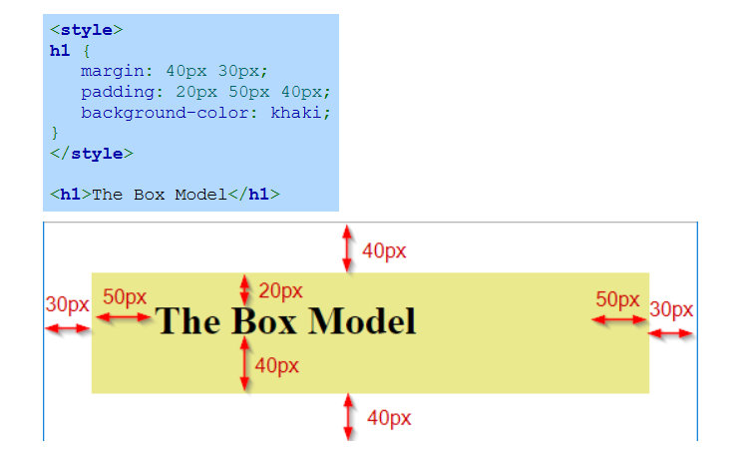
Example
Notes:
This example demonstrates the box model with an H1 element styled using margin and padding. The H1 has a margin of 40px vertically and 30px horizontally, creating space outside the element. The padding is set to 20px at the top and bottom, and 50px on the left and right, creating space inside the element. The background-color khaki highlights the area covered by the content and padding combined.

Slide 9
Content width and height
Block elements span the parent's width by default; size adjusts with width and height properties.
The width property specifies the content's width. Ex: width: 20px; makes the content 20px wide.
The height property specifies the content's height. Ex: height: 30px; makes the content 30px high.
Notes:
Now move on to width and height property. Block elements span the full width of their parent by default, but their size can be adjusted using the width and height properties. The width property specifies the horizontal size of the content, such as width 20px to make the element 20px wide. The height property specifies the vertical size, like height 30px to set the element height to 30px. These properties enable precise content sizing.

Slide 10
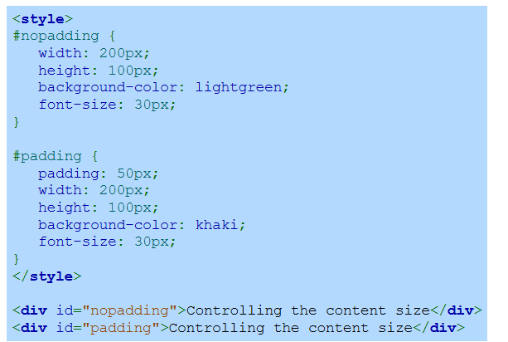
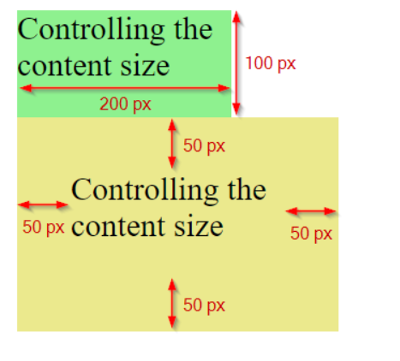
Example
Notes:
This example compares two div elements with and without padding. The first div has a width of 200px and height of 100px, shown in light green. The second div adds 50px padding, expanding the total visual area while keeping the content size the same, shown in khaki. Padding creates additional space inside the element, separating content from the edges without affecting the defined width and height.

Slide 11
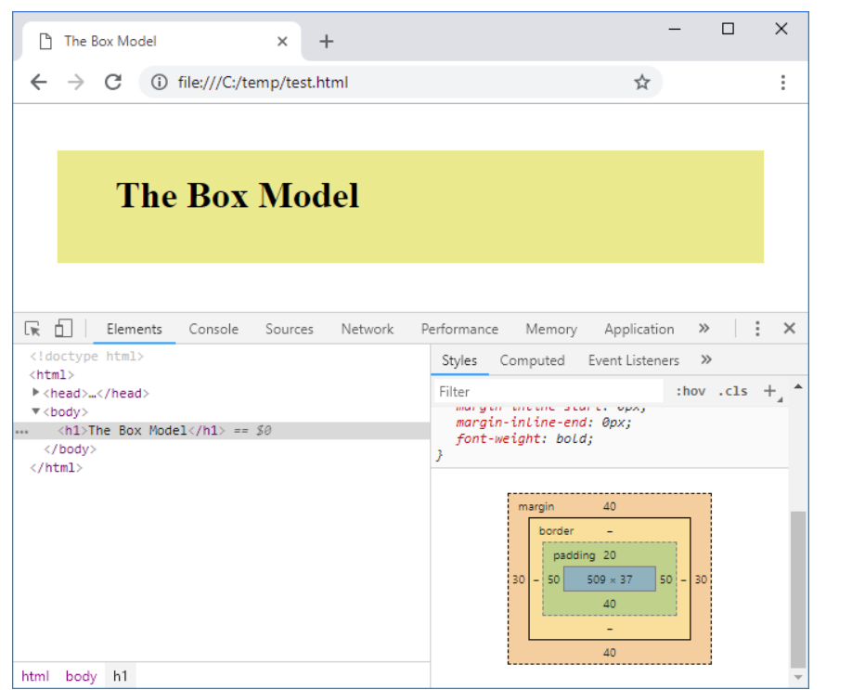
View Box Model using Chrome Dev Tools
Notes:
Box model can be inspect using Chrome Dev Tools to visualize the box model of any element. Select an element in the Elements panel, and the Computed tab displays a detailed box model diagram. It highlights the content, padding, border, and margin sizes. This tool is useful for understanding and debugging spacing issues and refining layout designs effectively in real-time.

Slide 12
Border Styles
The border property combines the border width, style, and color. Each CSS property may also be specified separately:
The border-width property specifies the border's width. Ex: border-width: 5px; specifies a border that is 5px thick.
The border-style property specifies the border's style. Ex: border-style: dashed; specifies a border that is dashed.
The border-color property specifies the border's color. Ex: border-color: green; specifies a border that is green.
Notes:
Let’s move on to the border property that combines width, style, and color for an element's border. Each can also be set separately. The border-width property defines the thickness, such as border-width 5px for a 5-pixel border. The border-style property specifies the type, like dashed for a dashed border. The border-color property sets the color, such as border-color green for a green border.

Slide 13
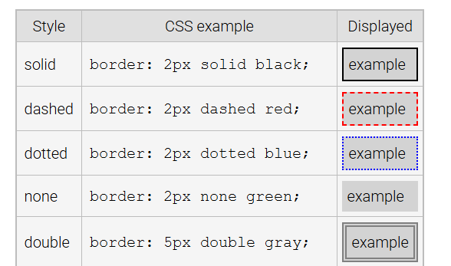
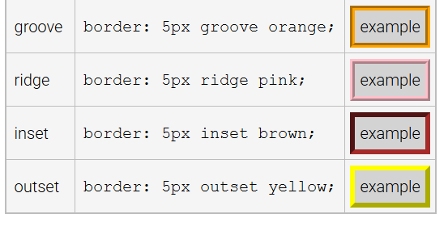
Common Border Styles
Notes:
This slide shows common CSS border styles. Solid creates a single solid line, dashed has a series of dashes, and dotted uses dots. None removes the border, and double creates two lines. Groove gives a 3D effect appearing carved in, ridge gives a raised effect, inset makes it look embedded, and outset makes it appear raised outward. Each style is defined using the border property with appropriate values.

Slide 14
Margin collapsing and horizontal centering
Vertical margins: Can collapse into a single space.
Horizontal margins: Never collapse.
Example: Vertically stacked block elements have combined margins.
Resulting size: Matches the larger of the two adjoining margins.
Notes:
In CSS, vertical margins of adjacent block elements can collapse into a single margin, with the resulting size equal to the larger margin. Horizontal margins, however, never collapse. For example, when two vertically stacked elements have margins, their combined margin is determined by the larger value. This behavior optimizes layout spacing and reduces unnecessary gaps between elements.

Slide 15
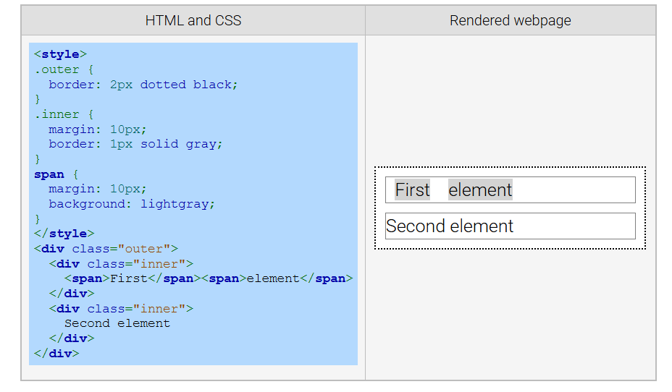
Example of Collapsed Margins
Notes:
This example illustrates margin collapsing in CSS. The outer div has a 2px dotted border, and the inner divs have a 10px margin and 1px solid border. The margins of adjacent elements collapse into a single margin, reducing extra space. The span elements also have a 10px margin. This behavior optimizes layout spacing and ensures consistent alignment in nested or stacked elements.

Slide 16
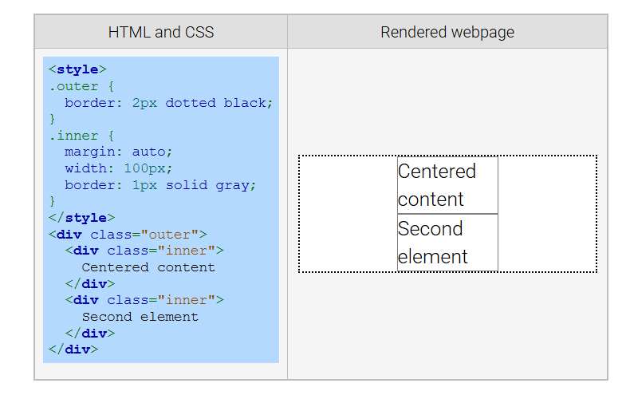
Example Horizontal Centering
Notes:
This example demonstrates horizontal centering using CSS. The inner div has a fixed width of 100px, and margin auto is applied, which centers the div horizontally within the outer container. The outer div has a dotted 2px border, while the inner div has a solid 1px border. The margin auto technique is commonly used to center block elements in a responsive and visually balanced layout. Thanks for watching the lecture.

